Slide 1

Class 3 – Regression
Pedram Jahangiry
Fall 2019

Slide 2
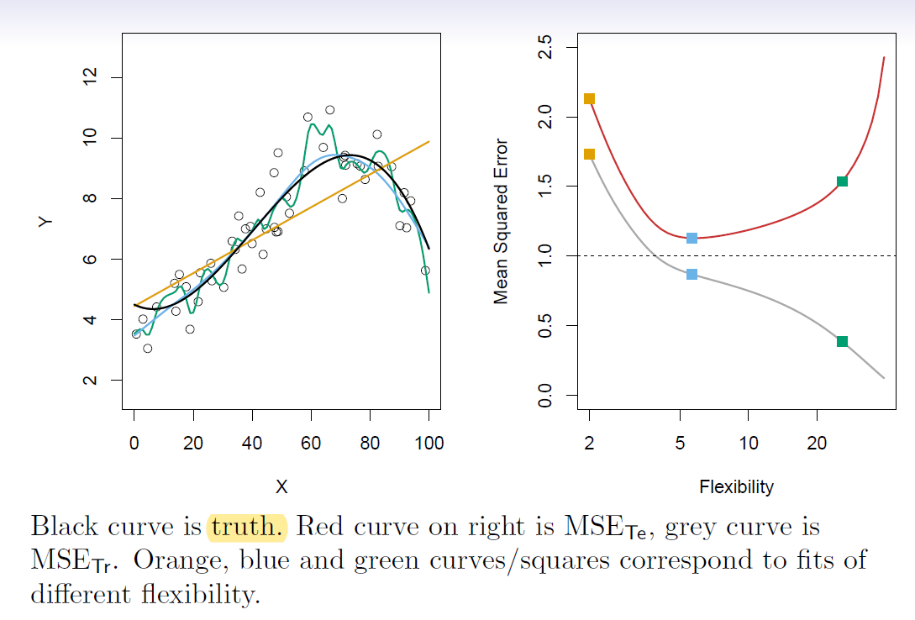
Training vs. Test MSE

Slide 3
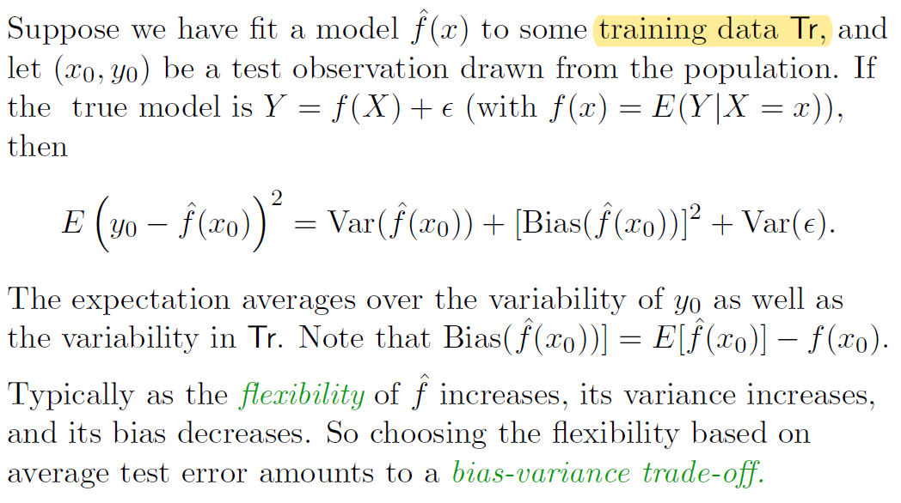
Bias-Variance Trade-off

Slide 4
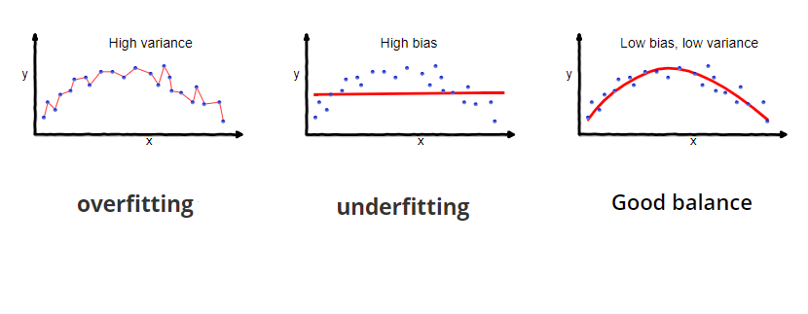
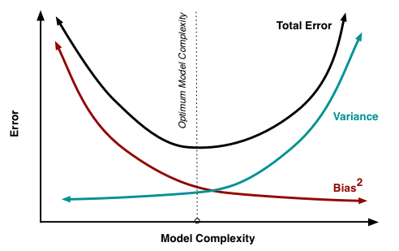
Notes:
Very low variance vs Extremely low bias

Slide 5
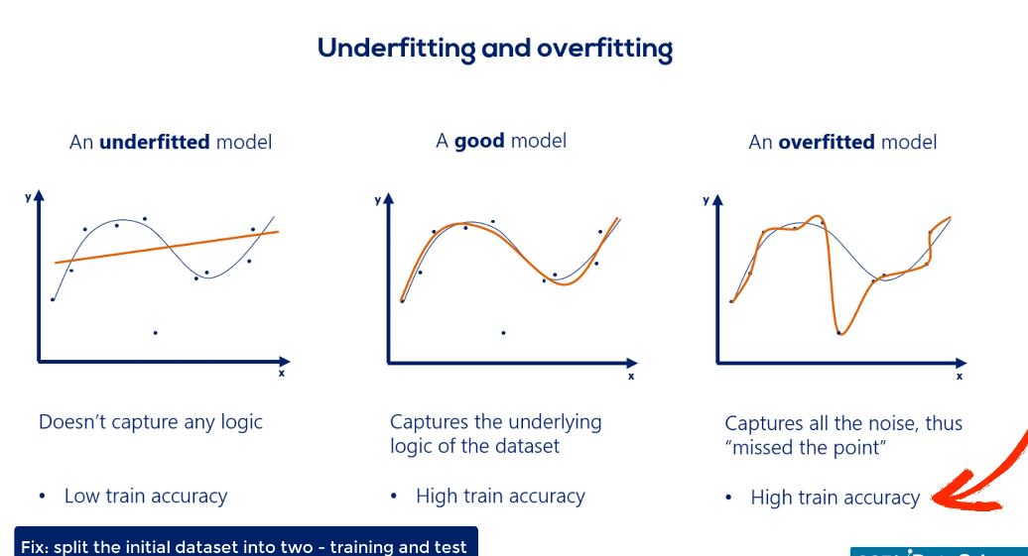

Slide 6
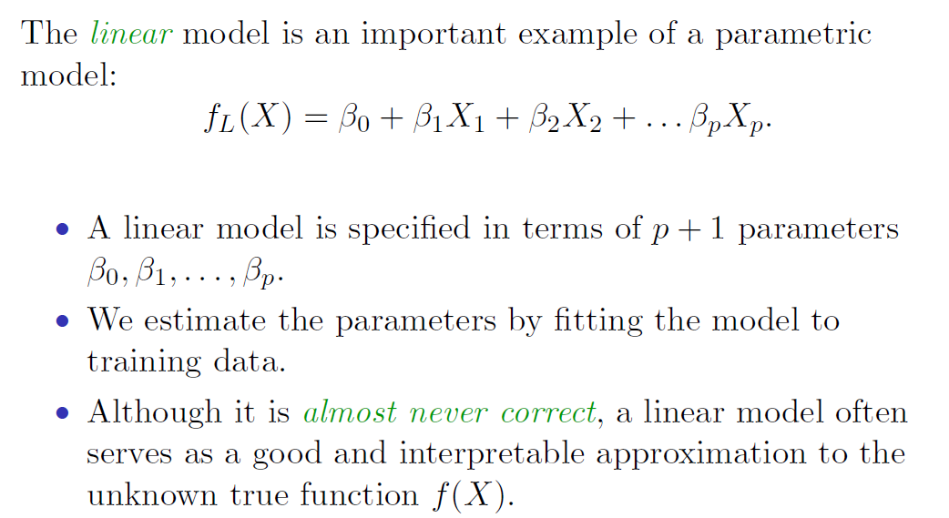
Linear Models

Slide 7
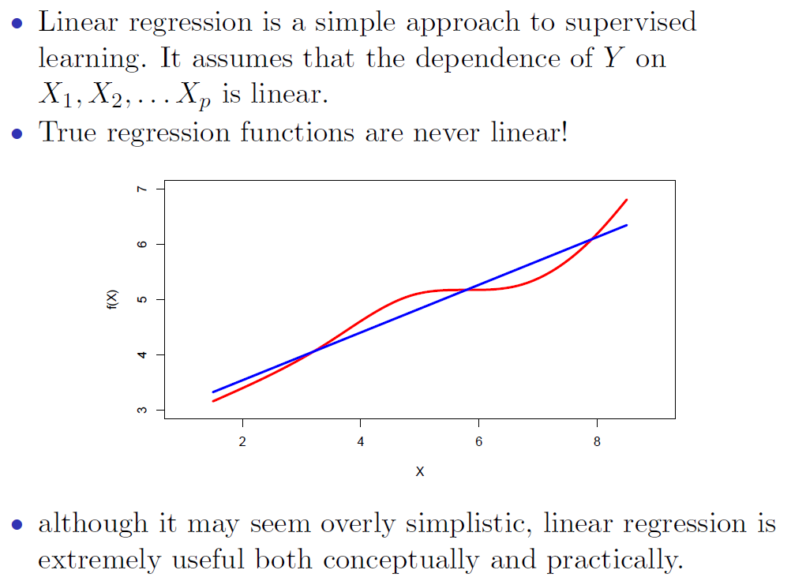
Linear Regression

Slide 8
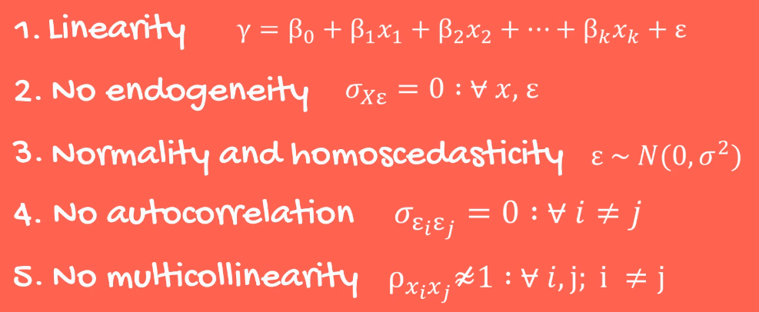
Assumptions of the OLS framework
If any of these assumptions is violated, then you cannot use OLS

Slide 9
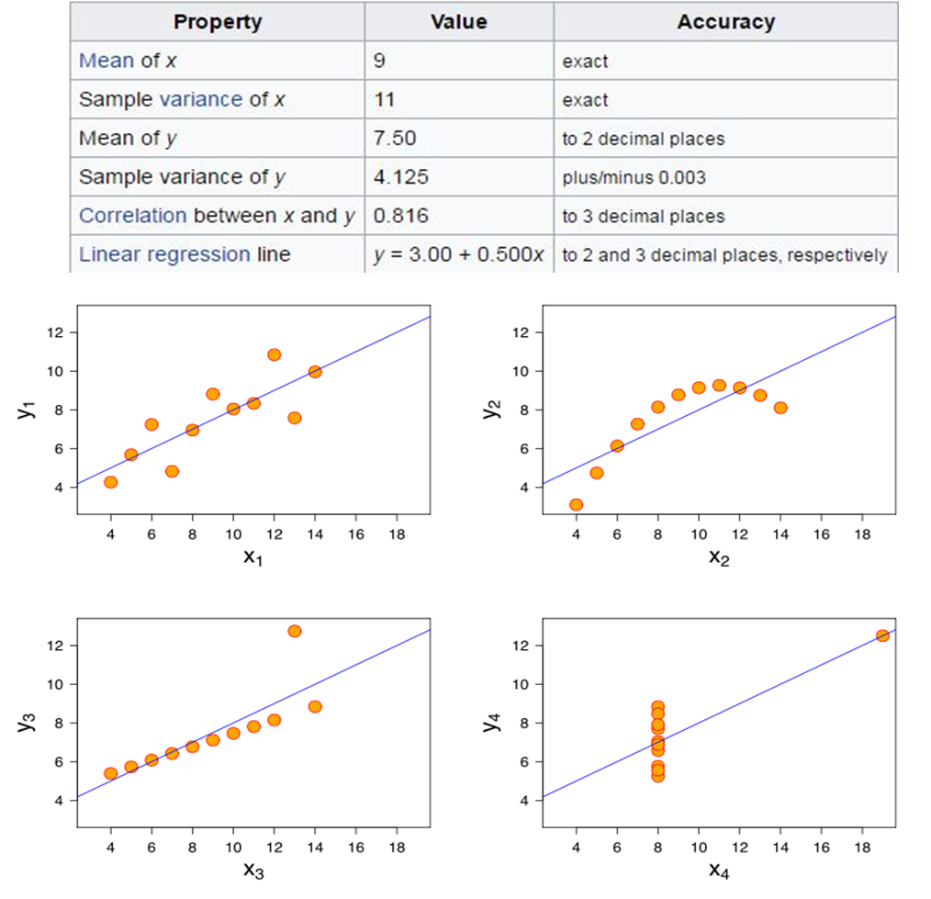
Notes:
Remember, correlation captures the linear relationship between variables!!

Slide 10
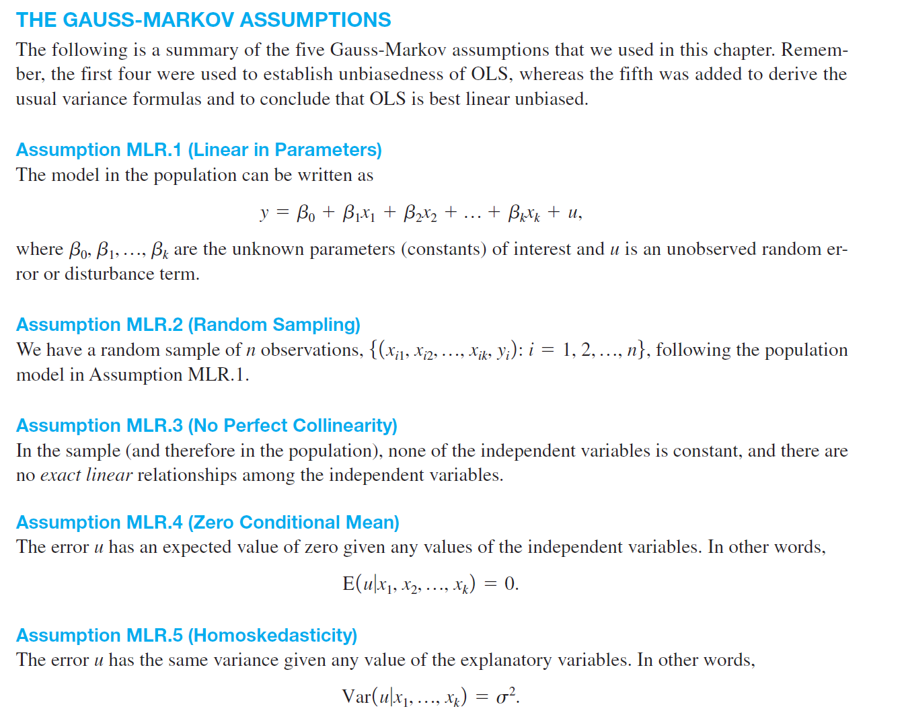
GAUSS MARKOV ASSUMPTIONS FOR REGRESSION
Notes:
Can quickly mention no autocorrelation assumption as well. Errors are independent over time. (moving to AR, ARMA and ARIMA)

Slide 11
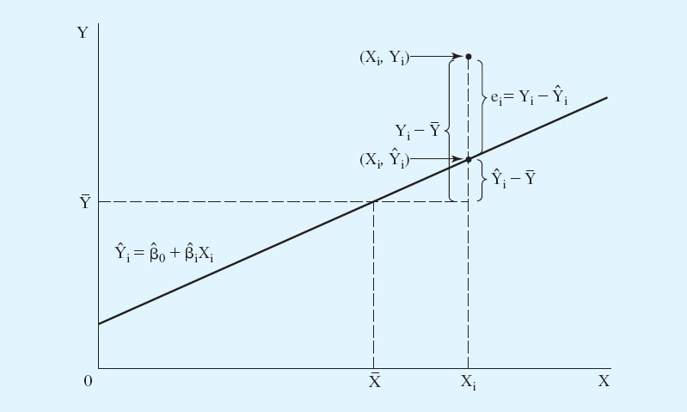






Decomposition of the variance in $y$
$$u_{i}=Y_{i}−\hat{Y_{i}}$$
$$Y_{i}−\overline{Y}$$
$$\hat{Y_{i}}−\overline{Y}$$
$$\overline{Y}$$
$\overline{X}$

Slide 12


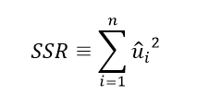
Measures of Variation
Total sum of squares,
Represents total sample
variation in y
Explained sum of squares,
Represents variation
Explained by regression
Residual sum of squares,
Represents variation
not Explained by regression
Notes:
How do we measure these variations? By squaring them and comparing them. Other wise will cancel out each other.

Slide 13

Decomposition of Total Variation
Total variation
Explained part
Unexplained part
Goodness-of-fit ($R^{2}$ or coefficient of determination)
How well does the explanatory variable explain the dependent variable?
R-squared measures the fraction of the total variation that is explained by the regression
Notes:
It can be shown that R2 is correlation2: So it measures the linear relation between two variables. Remember, y=x^2. R2 for SRM is corr= 0

Slide 14
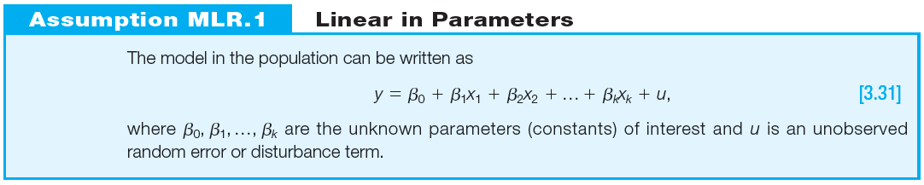
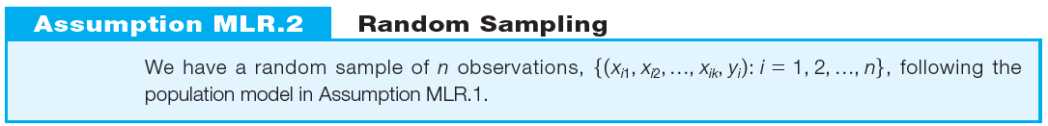
Standard assumptions for the multiple regression model

Slide 15
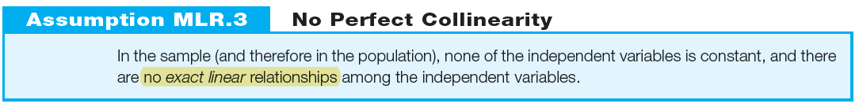
Standard assumptions for the multiple regression model
The assumption only rules out perfect collinearity/correlation between explanatory variables; imperfect correlation is allowed
If an explanatory variable is a perfect linear combination of other explanatory variables it is superfluous and may be eliminated
MLR.3 fails if $n<k+1$. Intuitively, this makes sense: to estimate $k+1$parameters, we need at least $k+1$observations.
Notes:
What if there is perfect collinearity? Then OLS cannot does it job and find the beta hats.
It is important to note that Assumption MLR.3 does allow the independent variables to be correlated; they just cannot be perfectly correlated.
In fact there is always gonna be some correlation between xs. Remember, expend and avg family income.
Imperfect correlation like x and x^2 (for x>0) . Our example for cons = inc + inc^2 does not violate this assumption. But the log version violates! We should include log(x)^2 and not log(x^2)
Perfect correlation like x and 2x

Slide 16

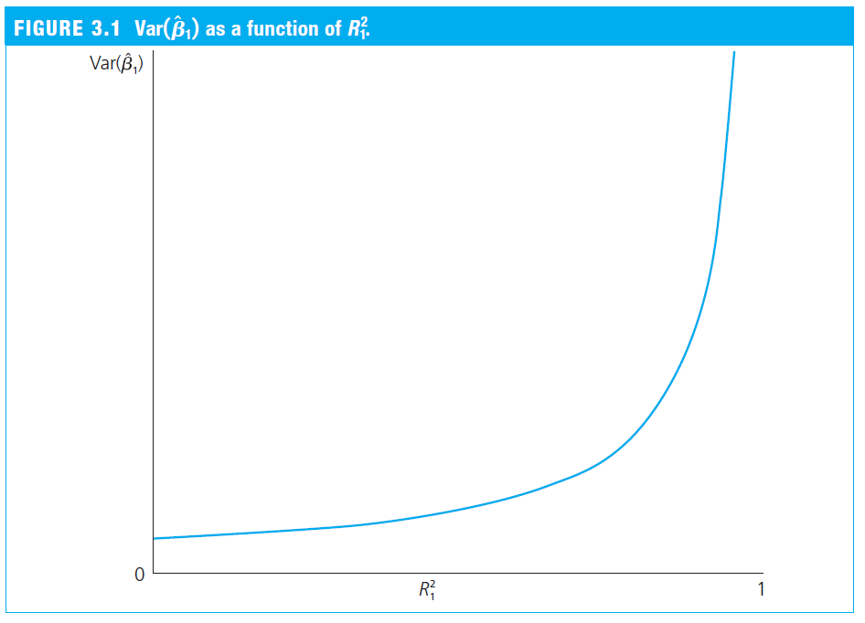
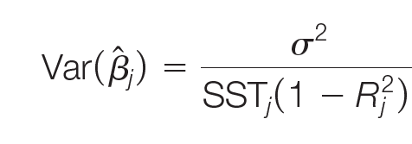
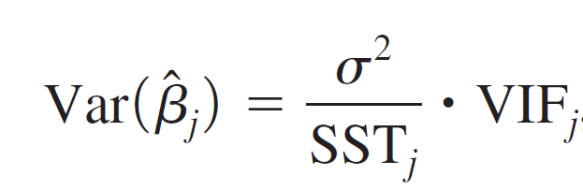
Detecting multicollinearity
Multicollinearity may be detected through Variance Inflation Factors:
As an arbitrary rule of thumb, the variance inflation factor should not be larger than 10
Notes:
This is arbitrary and honestly not helpful. Remember, var(b) depends on sigma and sst as well.
Do we really need independence? In the picture
I have few wife with (VIF)

Slide 17
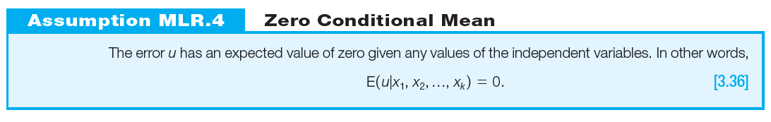
Standard assumptions for the multiple regression model (cont.)
The value of the explanatory variables must contain no information about the mean of the unobserved factors
In a multiple regression model, the zero conditional mean assumption is much more likely to hold because fewer things end up in the error.

Slide 18
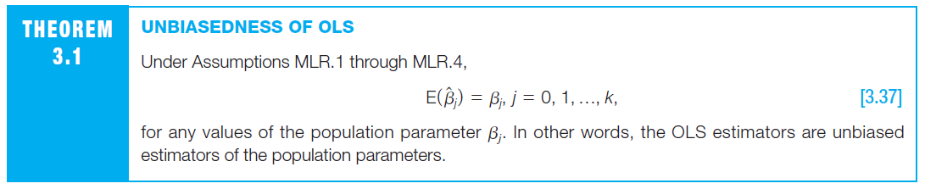

Theorem 3.1 (Unbiasedness of OLS)
Unbiasedness is an average property in repeated samples;
In a given sample, the estimates may still be far away from the true values!
Notes:
We are now ready to show unbiasedness of OLS under the first four multiple regression assumptions.
We will test for that later, H_0: betahat =0
When we say that OLS is unbiased under Assumptions MLR.1 through MLR.4, we mean that the procedure by which the OLS estimates are obtained is unbiased when we view the procedure as being applied across all possible random samples.

Slide 19
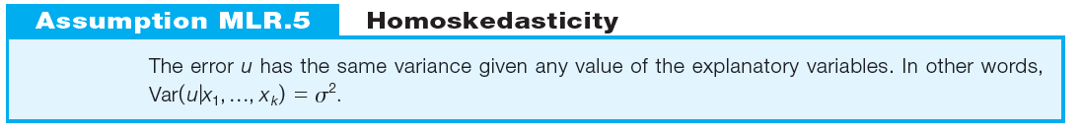
Standard assumptions for the multiple regression model (cont.)
The value of the explanatory variables must contain no information about the variance of the unobserved factors
Example: Wage equation
This assumption may also be hard to justify in many cases

Slide 20
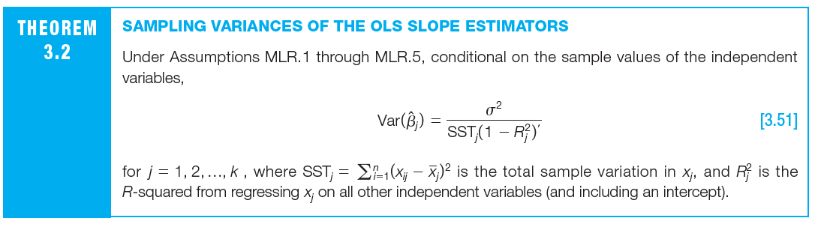
The sampling variability of the estimated regression coefficients depends on 4 things:
Variability of the unobserved factors ( $σ^{2}$)
Variation in the explanatory variable $var\left(X_{j}\right) or SST_{j}$
Number of observations $n$
Linear relationships among the independent variables $\left(R^{2}\right)$

Slide 21
Testing for Heteroskedasticity
There are many tests for heteroskedasticity; two popular:
Breusch-Pagan test
White test
Before testing for heteroskedasticity, start with asking:
Are there any obvious specification errors?
Are there any early warning signs of heteroskedasticity?
Does a graph of the residuals show any evidence of heteroskedasticity?

Slide 22
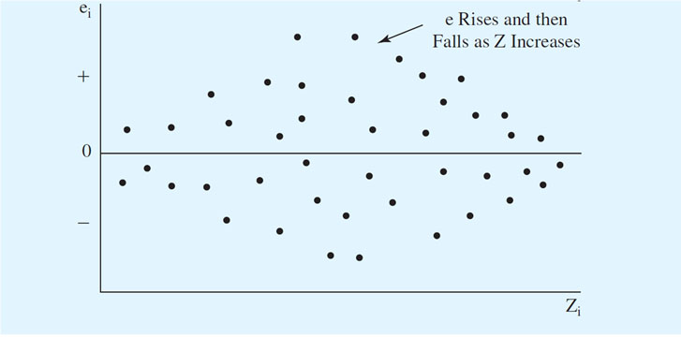
Testing for Heteroskedasticity (cont’d)
Eyeballing Residuals for Possible Heteroskedasticity
If you plot the residuals of an equation with respect to a potential explanatory variable Z, a pattern in the residuals is an indication of possible heteroskedasticity.

Slide 23
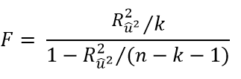

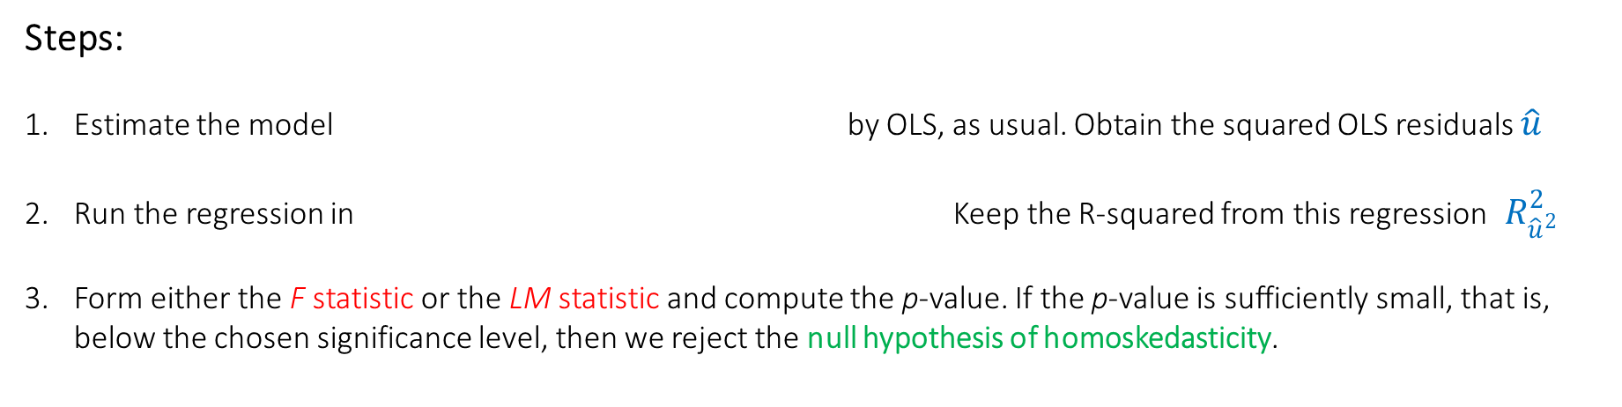
The Breusch-Pagan Test for Heteroskedasticity:
Steps:
Estimate the model by OLS, as usual. Obtain the squared OLS residuals $\hat{u}$
Run the regression in Keep the R-squared from this regression${ R}_{{\hat{u}}^{2}}^{2}$
Form either the F statistic or the LM statistic and compute the p-value. If the p-value is sufficiently small, that is, below the chosen significance level, then we reject the null hypothesis of homoskedasticity.
Regress squared residuals on all explanatory variables and test whether this regression has explanatory power.
A large F statistic or a large Lagrange multiplier statistic, (LM) lead to rejection of the null hypothesis.

Slide 24

The White Test for Heteroskedasticity
Steps:
Estimate the model by OLS, as usual. Obtain the squared OLS residuals $\hat{u}$
Run the regression in Keep the R-squared from this regression${ R}_{{\hat{u}}^{2}}^{2}$
Form either the F statistic or the LM statistic and compute the p-value. If the p-value is sufficiently small, that is, below the chosen significance level, then we reject the null hypothesis of homoskedasticity.
Regress squared residuals on all explanatory variables, their squares, and interactions
(here: example for k=3)
A large F statistic or a large Lagrange multiplier statistic, (LM) lead to rejection of the null hypothesis.

Slide 25
Remedies for Heteroskedasticity
If heteroskedasticity is found, the first thing to do is examine the equation carefully for specification errors.
If there are no obvious specification errors, the heteroskedasticity is probably pure in nature and one of the following remedies should be considered.
Redefining the Variables
Heteroskedasticity-Corrected Standard Errors
Weighted Least Square Estimation!

